Slide 1


Project presentation
Medi-Caps University
PHASE 1
VIRTUAL VOICE ASSISTANT
GUIDED BY : – RAJESH KHARCHE
SUBMITTED BY:- DEEPESH BARDE VISHAL CHOUDHARY

Slide 2
INTRODUCTION
In today’s era almost all tasks are digitalized. We have Smartphone in hands and it is nothing less than having world at your finger tips. Virtual Assistants are software programs that help you ease your day to day tasks, such as showing weather report, Playing music, mail someone etc. They can take commands via text (online chat bots) or by voice. For sure we already have some voice assistant like Apple’s SIRI , Google Assistant , Amazon’s Alexa , Microsoft's Cortona and etc. But nothing is better than having a own one . We can send mail , we can send whatsapp message , we can search anything , Wikipedia anything and able to open applications.

Slide 3
Problem investigation
As we are moving forward with technologies , we are trying to make it more and more effortless, for example we already have multi tasking and fast computers which is already automating many of our manual work .
But some how we still want some more effortless work to do like if we are working in an application and we want to open another so we have to open it manually , but we want to do it just by telling it.
To save more time and spent it to do any greater!

Slide 4
System analysis
System Analysis is about complete understanding of existing systems and finding where the existing system fails. The solution is determined to resolve issues in the proposed system.
REQUIREMENT SPECIFICATION
Personal assistant software is required to act as an interface into the digital world by understanding user requests or commands and then translating into actions or recommendations based on agent’s understanding of the world.
HARDWARE AND SOFTWARE REQUIREMENTS
Hardware:
Pentium-pro processor or later
RAM 512MB or more.
Software:
Windows 7(32-bit) or above.
Python 2.7 or later
Pycharm
SQLite

Slide 5
Approach of development
Gather and document requirements
Design
Code and unit test
Perform system testing
Perform user acceptance testing (UAT)
Fix any issues
Deliver the finished product

Slide 6
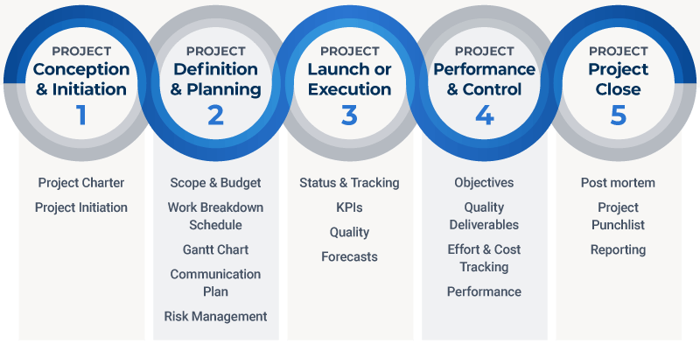
Project planning

Slide 7
Thank you

